Slide 1
jQuery
Pat Morin COMP2405

Slide 2
jQuery
jQuery is a JavaScript Library.
jQuery is a lightweight, "write less, do more", JavaScript library.
The purpose of jQuery is to make it much easier to use JavaScript on your website.
jQuery takes a lot of common tasks that require many lines of JavaScript code to accomplish and wraps them into methods that you can call with a single line of code.
jQuery also simplifies a lot of the complicated things from JavaScript, like AJAX calls and DOM manipulation.

Slide 3
jQuery Library Features
HTML/DOM manipulation
CSS manipulation
HTML event methods
Effects and animations
AJAX
Utilities

Slide 4
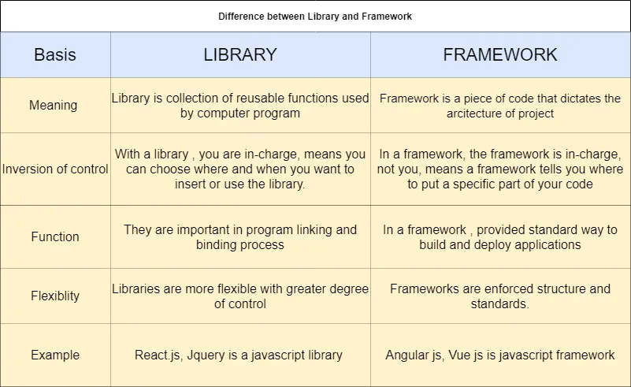
Difference between Library and Framework

Slide 5
jQuery on Your Website
Download the jQuery library from jQuery.com
Include jQuery from a CDN, like Google

Slide 6
jQuery Syntax
Basic syntax is: $(selector).action()
A $ sign to define/access jQuery
A (selector) to "query (or find)" HTML elements
A jQuery action() to be performed on the element(s)

Slide 7
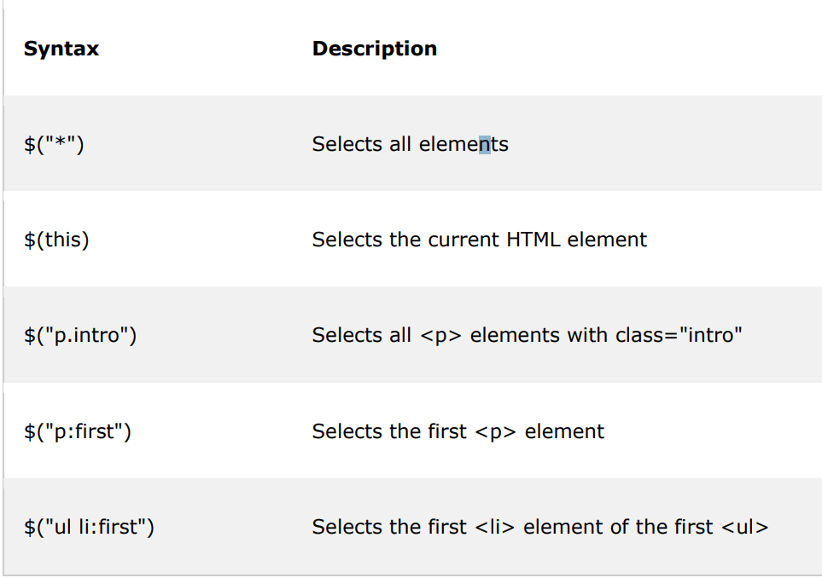
Example

Slide 8
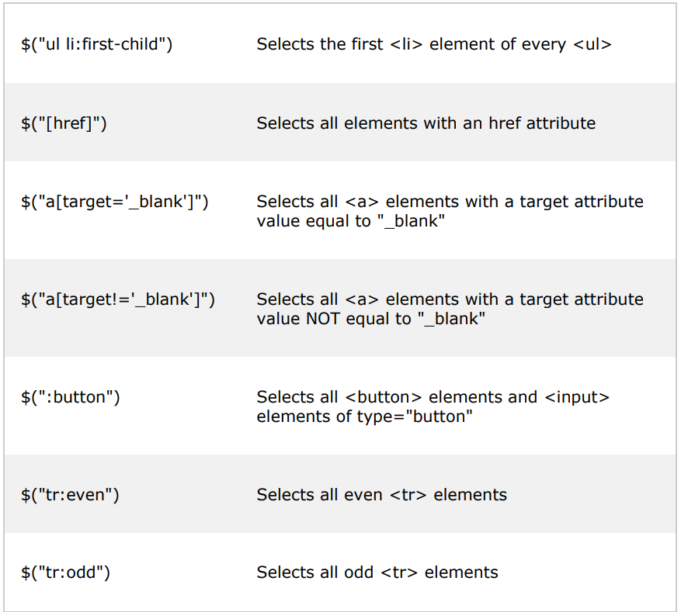
Example

Slide 9
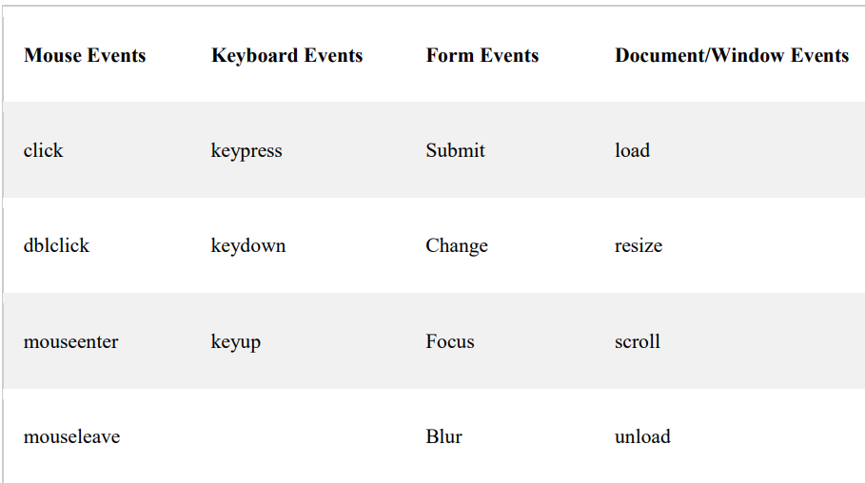
jQuery Events

Slide 10
Traversing
jQuery traversing, which means "move through", are used to "find" (or select) HTML elements based on their relation to other elements.
Start with one selection and move through that selection until you reach the elements you desire.
The image below illustrates an HTML page as a tree (DOM tree).
With jQuery traversing, you can easily move up (ancestors), down (descendants) and sideways (siblings) in the tree, starting from the selected (current) element.
This movement is called traversing - or moving through - the DOM tree.

Slide 11
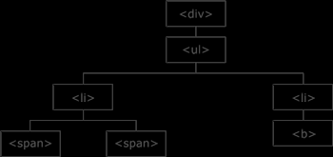
DOM tree

Slide 12
jQuery Traversing - Ancestors
Three useful jQuery methods for traversing up the DOM tree are:
parent()
parents()
parentsUntil()

Slide 13
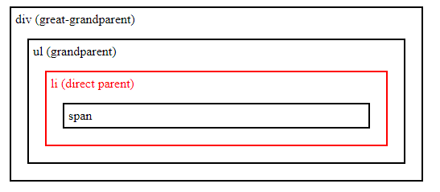
Parent()
The parent() method returns the direct parent element of the selected element.
This method only traverse a single level up the DOM tree.
$(document).ready(function(){
$("span").parent().css({"color": "red", "border": "2px solid red"}
);
});

Slide 14
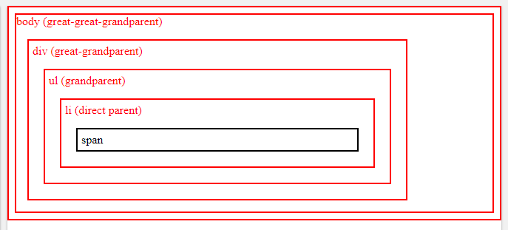
Parents()
The parents() method returns all ancestor elements of the selected element, all the way up to the document's root element (<html>).
$(document).ready(function(){
$("span").parents().css({"color": "red", "border": "2px solid red"});
});

Slide 15
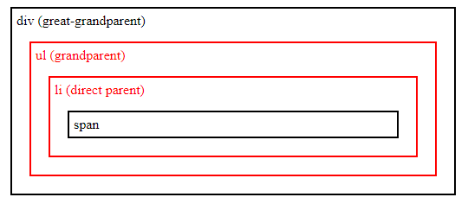
parentsUntil()
The parentsUntil() method returns all ancestor elements between two given arguments.
The following example returns all ancestor elements between a <span> and a <div> element:
$(document).ready(function(){
$("span").parentsUntil("div").css({"color": "red", "border": "2px solid red"});
});

Slide 16
jQuery Traversing - Decendants
With jQuery you can traverse down the DOM tree to find descendants of an element.
Two useful jQuery methods for traversing down the DOM tree are:
children()
find()

Slide 17
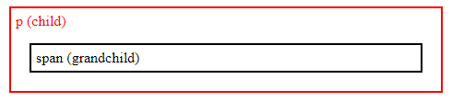
Children()
The children() method returns all direct children of the selected element.
This method only traverses a single level down the DOM tree.
$(document).ready(function(){
$("div").children().css({"color": "red", "border": "2px solid red"});
});

Slide 18
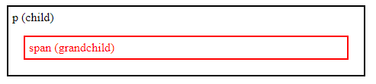
find()
The find() method returns descendant elements of the selected element, all the way down to the last descendant.
$(document).ready(function(){
$("div").find("span").css({"color": "red", "border": "2px solid red"});
});

Slide 19
jQuery Traversing - Siblings
With jQuery you can traverse sideways in the DOM tree to find siblings of an element.
Siblings share the same parent.
There are many useful jQuery methods for traversing sideways in the DOM tree.
siblings()
next()
nextAll()
nextUntil()
prev()
prevAll()
prevUntil()

Slide 20
Siblings()
The siblings() method returns all sibling elements of the selected element.
$(document).ready(function(){ $("h2").siblings(); });

Slide 21
next()
The next() method returns the next sibling element of the selected element.
$(document).ready(function(){ $("h2").next(); });

Slide 22
nextAll()
The nextAll() method returns all next sibling elements of the selected element.
$(document).ready(function(){ $("h2").nextAll(); });

Slide 23
nextUntil()
The nextUntil() method returns all next sibling elements between two given arguments.
$(document).ready(function(){ $("h2").nextUntil("h6"); });

Slide 24
jQuery Traversing- Filtering
The most basic filtering methods are first(), last() and eq(), which allow you to select a specific element based on its position in a group of elements.
Other filtering methods, like filter() and not() allow you to select elements that match, or do not match, a certain criteria.

Slide 25
first()
The first() method returns the first element of the specified elements.
$(document).ready(function(){
$("div").first().css("background-color", "yellow");
});

Slide 26
last()
The last() method returns the last element of the specified elements.
$(document).ready(function(){
$("div").last().css("background-color", "yellow");
});

Slide 27
filter()
The filter() method lets you specify a criteria. Elements that do not match the criteria are removed from the selection, and those that match will be returned.
The following example returns all <p> elements with class name "intro":
$(document).ready(function(){
$("p").filter(".intro").css("background-color", "yellow");
});

Slide 28
AJAX
AJAX = Asynchronous JavaScript and XML.
In short; AJAX is about loading data in the background and display it on the webpage, without reloading the whole page.
Examples of applications using AJAX: Gmail, Google Maps, Youtube, and Facebook tabs.

Slide 29
load() Method
The jQuery load() method is a simple, but powerful AJAX method.
The load() method loads data from a server and puts the returned data into the selected element.
Syntax:
$(selector).load(URL,data,callback);

Slide 30

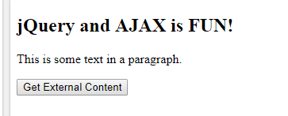
Example
$(document).ready(function(){
$("button").click(function(){
$("#div1").load("demo_test.txt");
});
});

Slide 31
get() and post() method
Two commonly used methods for a request-response between a client and server are: GET and POST.
GET - Requests data from a specified resource
POST - Submits data to be processed to a specified resource

Slide 32
get()
The $.get() method requests data from the server with an HTTP GET request.
Syntax:
$.get(URL,callback);

Slide 33
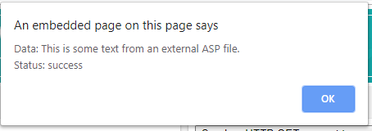
Example
$(document).ready(function(){
$("button").click(function(){
$.get("demo_test.asp", function(data, status){
alert("Data: " + data + "\nStatus: " + status);
});
});
});

Slide 34
post()
The $.post() method requests data from the server using an HTTP POST request.
Syntax:
$.post(URL,data,callback);

Slide 35
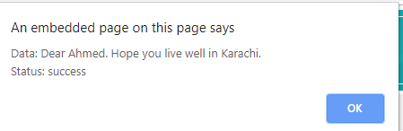
Example
$(document).ready(function(){
$("button").click(function(){
$.post("demo_test_post.asp",
{
name: "Ahmed",
city: "Karachi"
},
function(data,status){
alert("Data: " + data + "\nStatus: " + status);
});
});
});

